Slide 1

8th Grade Math: Pre-Algebra
Unit 11, Lesson 6 Interpreting Linear Equations Fit to Bivariate Data Volume 2, pg. 204

Slide 2


Benchmarks
MA.8.AR.3.5
Given a real-world context, determine and interpret the slope and 𝑦-intercept of a two-variable linear equation from a written description, a table, a graph, or an equation in slope-intercept form.
MA.8.DP.1.2
Given a scatter plot within a real-world context, describe patterns of association.
volume 2, pg. 204

Slide 3
Integrated Mathematical Thinking and Reasoning Standards
MA.K12.MTR.1.1 Actively participate in effortful learning both individually and collectively.
MA.K12.MTR.4.1 Engage in discussions that reflect on the mathematical thinking of self and others.
MA.K12.MTR.6.1 Assess the reasonableness of solutions.
MA.K12.MTR.7.1 Apply mathematics to real-world contexts.
volume 2, pg. 204

Slide 4

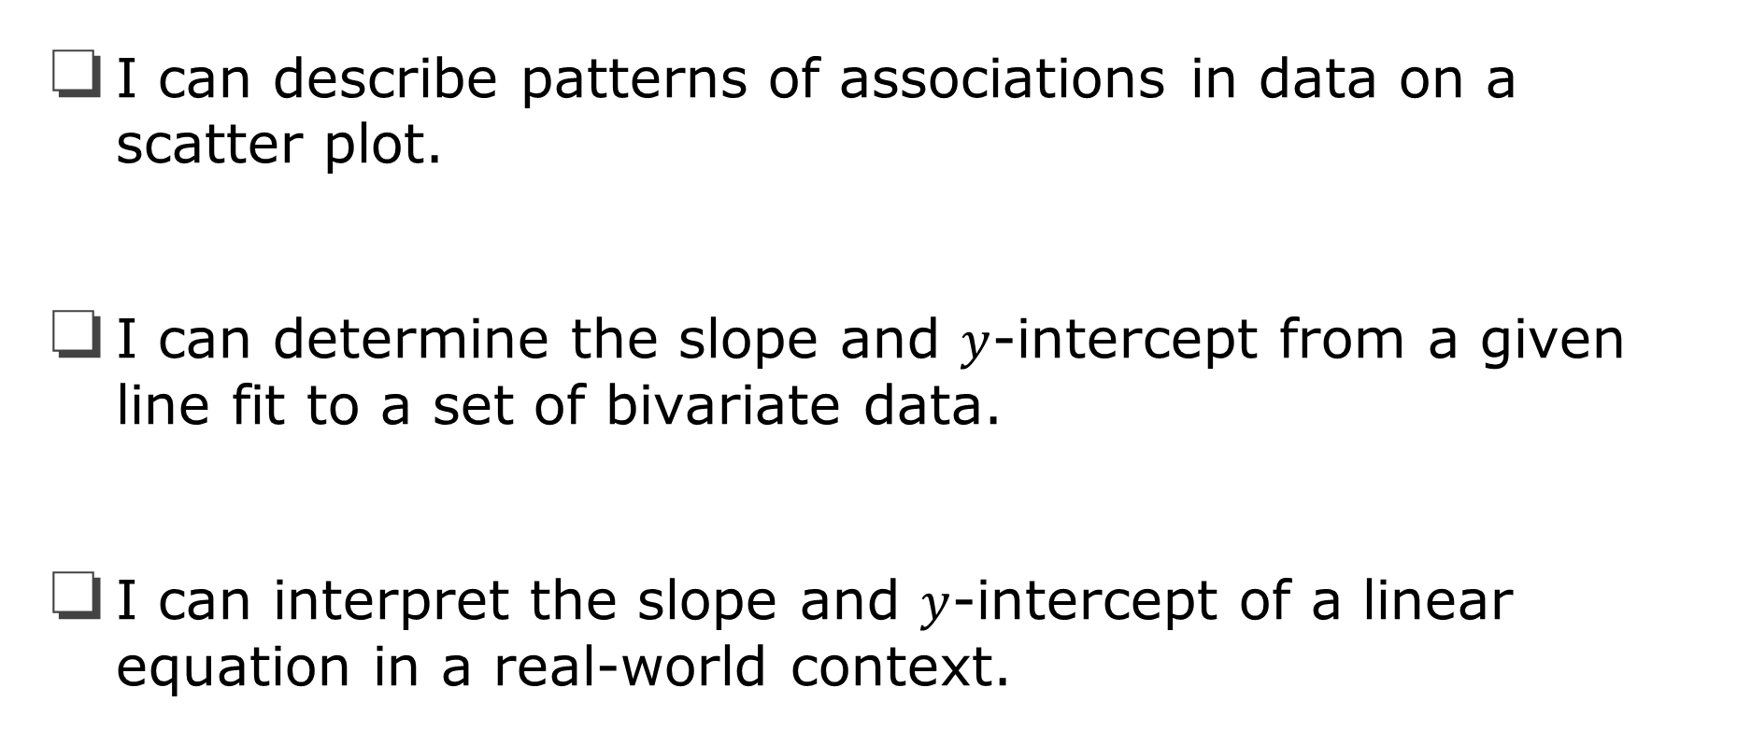
Learning Targets
I can describe patterns of associations in data on a scatter plot.
I can determine the slope and $y$-intercept from a given line fit to a set of bivariate data.
I can interpret the slope and $y$-intercept of a linear equation in a real-world context.
volume 2, pg. 204

Slide 5

Warm-Up
volume 2, pg. 204

Slide 6
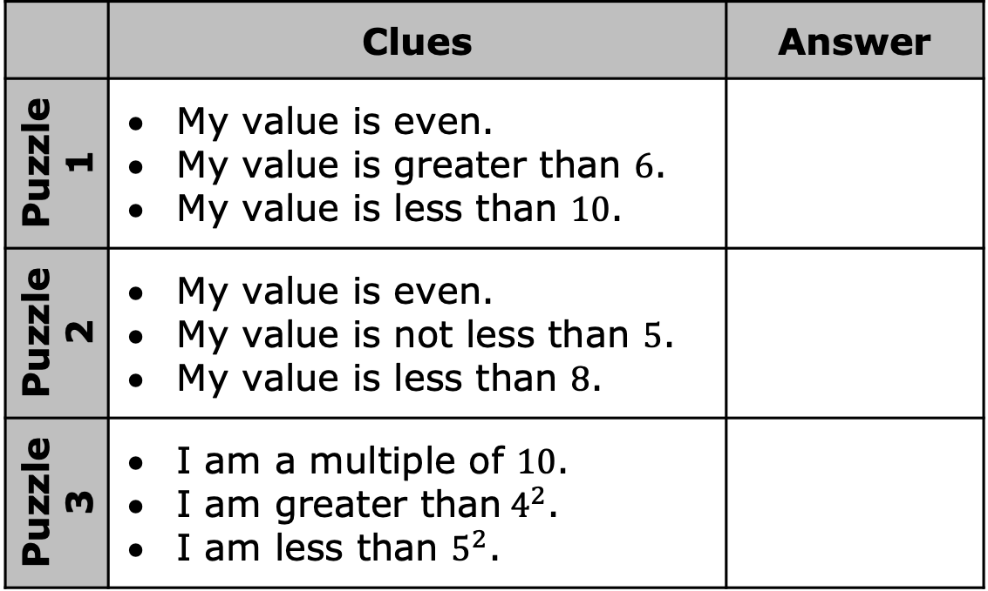
11.6.1 Warm-Up: Number Puzzles
Read the clues for each puzzle to find the answer.
 | Clues | Answer
Puzzle 1 | My value is even. My value is greater than $6$. My value is less than $10$.
Puzzle 2 | My value is even. My value is not less than $5$. My value is less than $8$.
Puzzle 3 | I am a multiple of $10$. I am greater than${ 4}^{2}$. I am less than $5^{2}$.
What strategies did you use to determine the answer for each puzzle?
volume 2, pg. 204

Slide 7

Exploration
volume 2, pg. 205

Slide 8

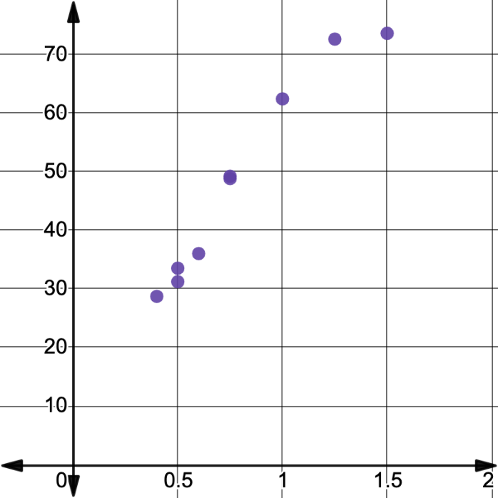
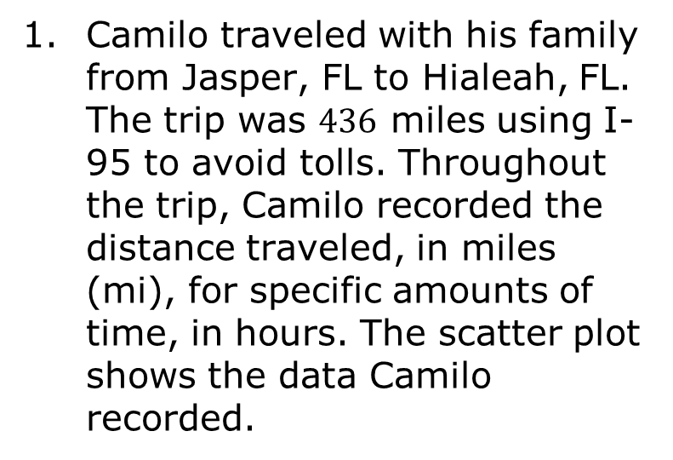
11.6.2 Exploration: Linear Equations Modeling Bivariate Data
Camilo traveled with his family from Jasper, FL to Hialeah, FL. The trip was $436$ miles using I-95 to avoid tolls. Throughout the trip, Camilo recorded the distance traveled, in miles (mi), for specific amounts of time, in hours. The scatter plot shows the data Camilo recorded.
Distance Traveled (mi)
Number of Hours Traveled
volume 2, pg. 205

Slide 9
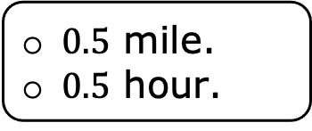

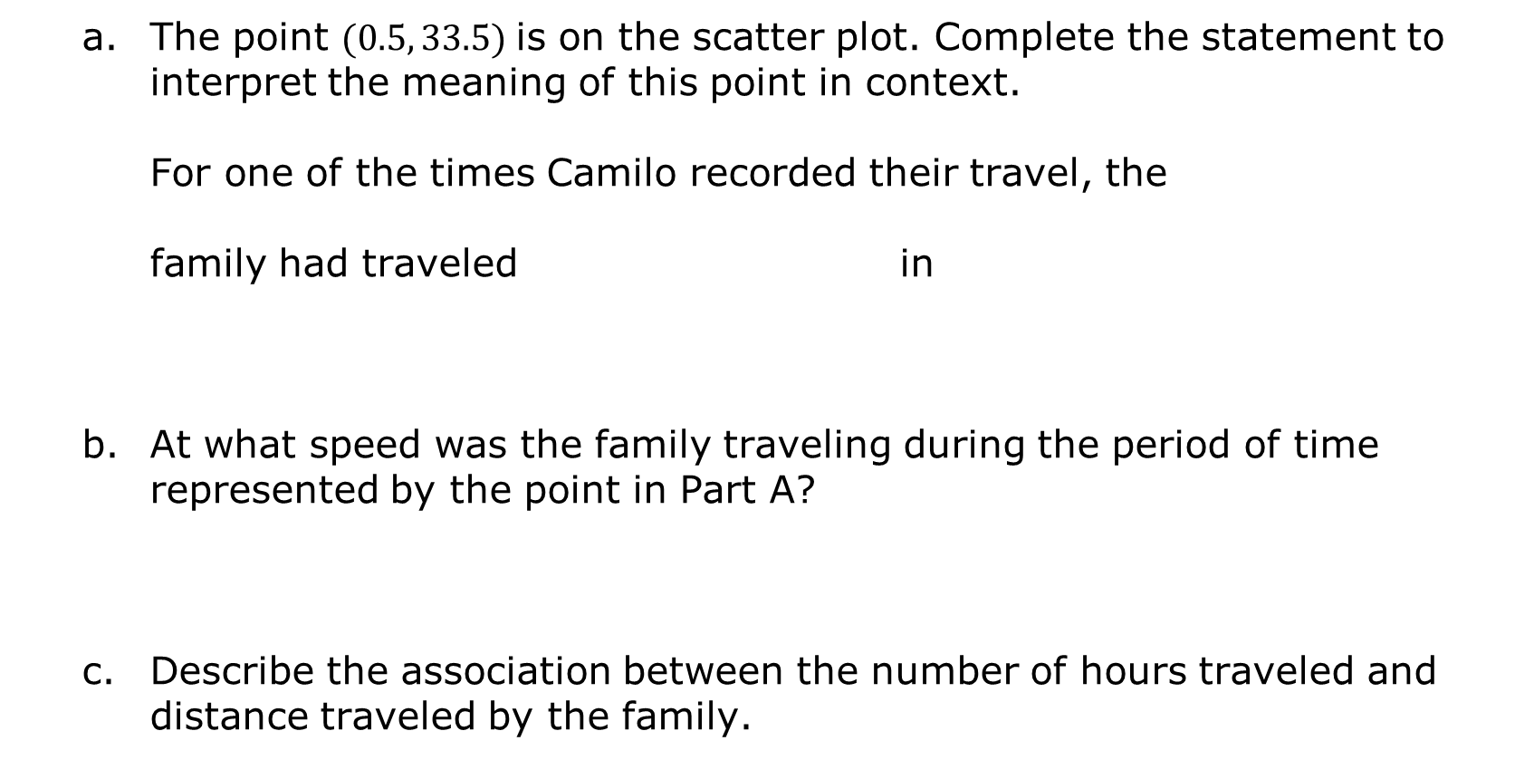
The point $(0.5, 33.5)$ is on the scatter plot. Complete the statement to interpret the meaning of this point in context.
For one of the times Camilo recorded their travel, the
family had traveled in
At what speed was the family traveling during the period of time represented by the point in Part A?
Describe the association between the number of hours traveled and distance traveled by the family.
$33.5$ miles
$33.5$ hours
$0.5$ mile.
$0.5$ hour.
volume 2, pg. 205

Slide 10
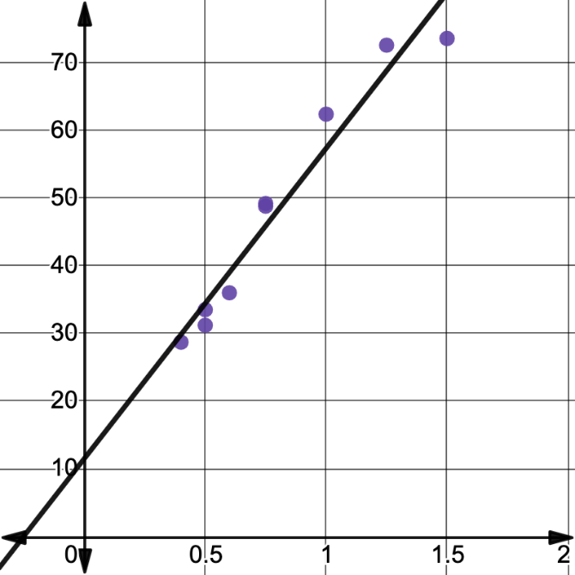

Suppose the line shown is fit to the data.
The equation of the line of fit is $y=45.9x+11.5$.
Discuss with your partner what you think this line of fit represents in this context. Summarize your discussion.
Distance Traveled (mi)
Number of Hours Traveled
volume 2, pg. 205

Slide 11
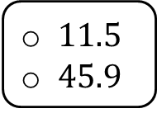

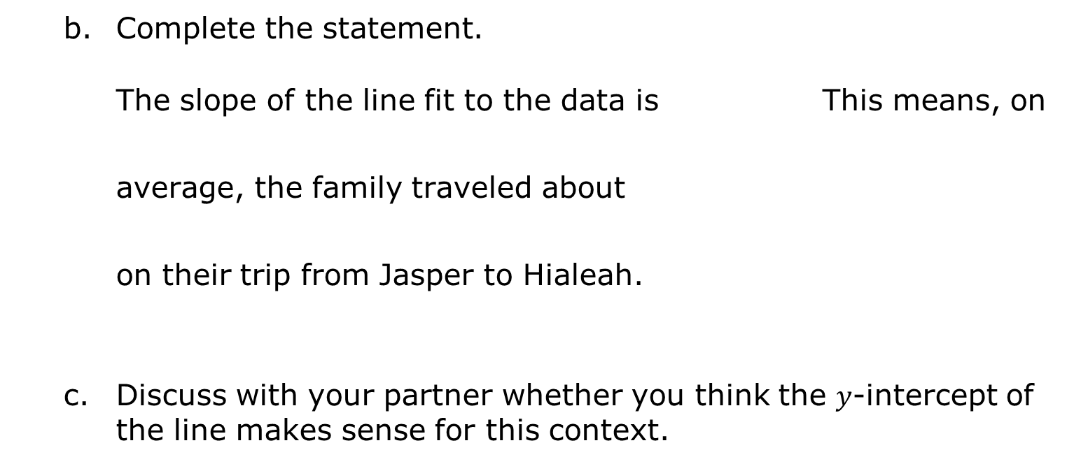
Complete the statement.
The slope of the line fit to the data is This means, on average, the family traveled about on their trip from Jasper to Hialeah.
Discuss with your partner whether you think the $y$-intercept of the line makes sense for this context.
$11.5$.
$45.9$.
$11.5$
$45.9$
miles per hour
hours per mile
volume 2, pg. 206

Slide 12

Bring It Together
volume 2, pg. 206

Slide 13

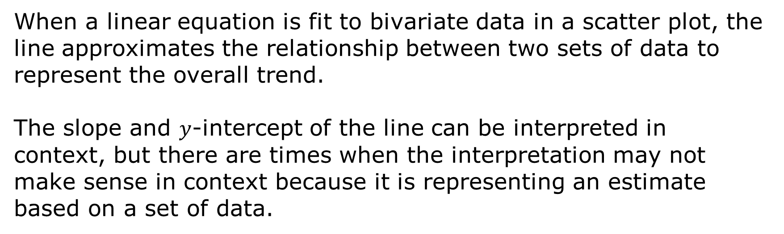
11.6.3 Bring It Together: Linear Equations Modeling Bivariate Data
When a linear equation is fit to bivariate data in a scatter plot, the line approximates the relationship between two sets of data to represent the overall trend.
The slope and $y$-intercept of the line can be interpreted in context, but there are times when the interpretation may not make sense in context because it is representing an estimate based on a set of data.
volume 2, pg. 206

Slide 14

Guided Practice
volume 2, pg. 207

Slide 15

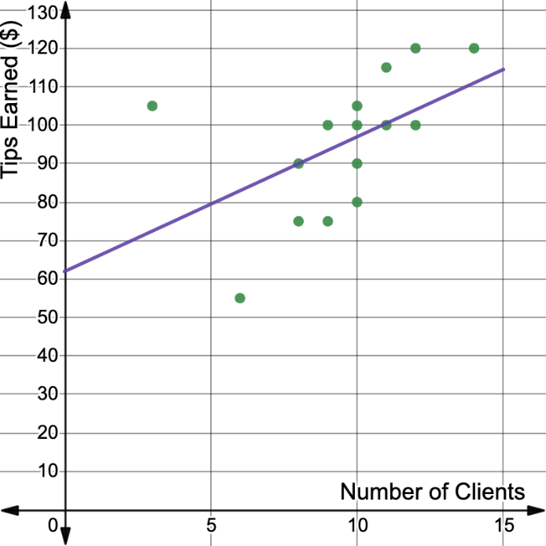
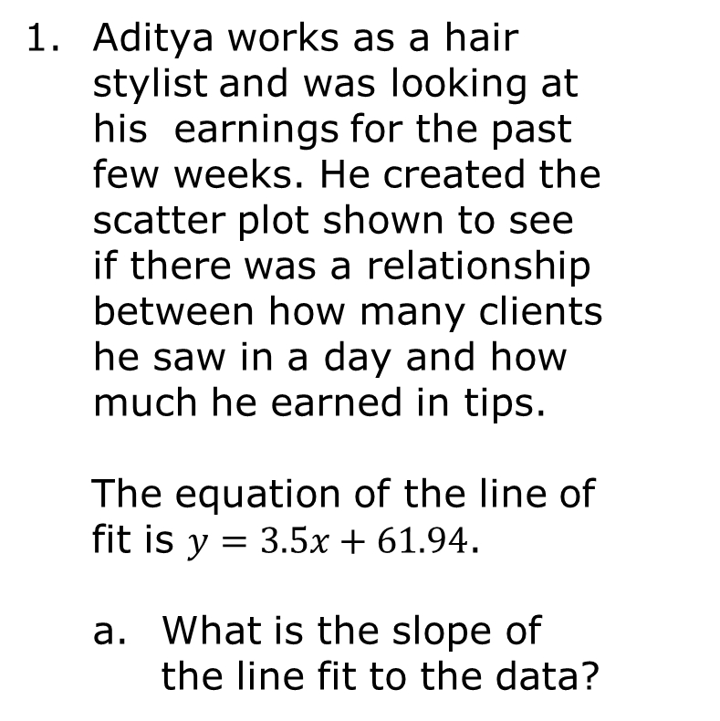
11.6.4 Guided Practice: Interpreting Equations Fit to Bivariate Data
Aditya works as a hair stylist and was looking at his earnings for the past few weeks. He created the scatter plot shown to see if there was a relationship between how many clients he saw in a day and how much he earned in tips.
The equation of the line of fit is $y=3.5x+61.94$.
What is the slope of the line fit to the data?
volume 2, pg. 207

Slide 16

Interpret the meaning of the slope in context.
Explain why the $y$-intercept of the line estimating the relationship between the variables does not make sense in this context.
volume 2, pg. 207

Slide 17
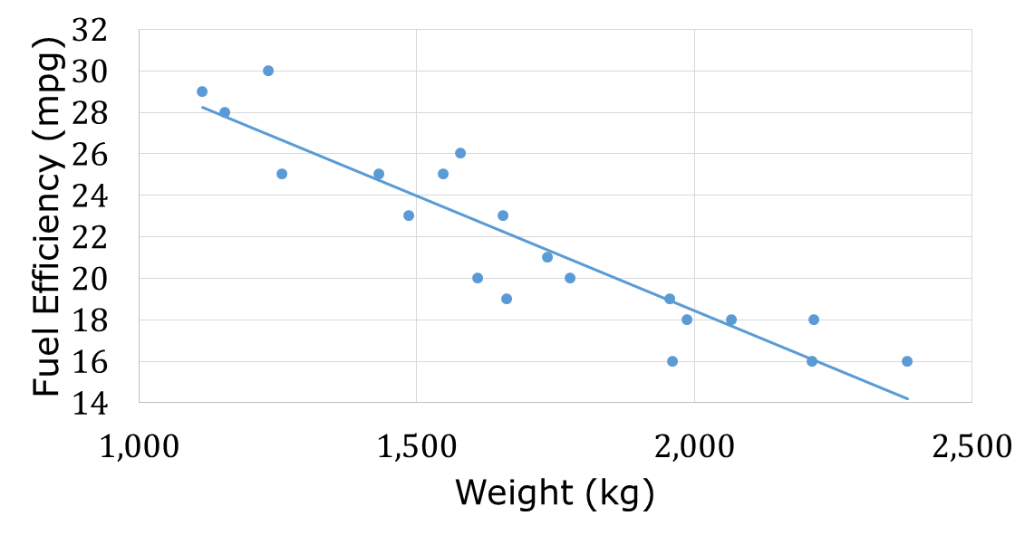

The scatter plot shown represents the relationship between a car’s weight, in kilograms (kg), and its fuel efficiency, in miles per gallon (mpg).
The equation of the line of fit is $y=−0.012x+41.3$.
volume 2, pg. 207

Slide 18
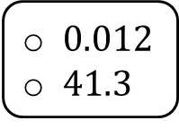
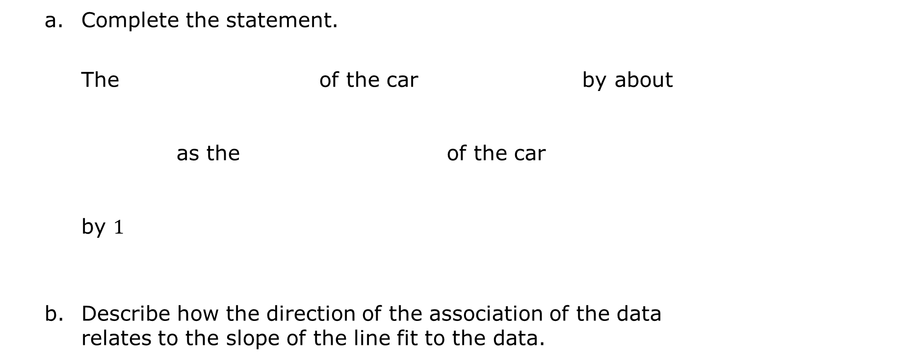
Complete the statement.
The of the car by about as the of the car by $1$
Describe how the direction of the association of the data relates to the slope of the line fit to the data.
weight
fuel efficiency
increases
decreases
$0.012$
$41.3$
kg
mpg
weight
fuel efficiency
increases
decreases
kg.
mpg.
volume 2, pg. 207

Slide 19

Your Turn
volume 2, pg. 208

Slide 20
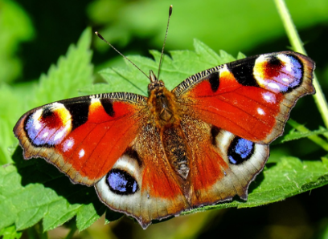
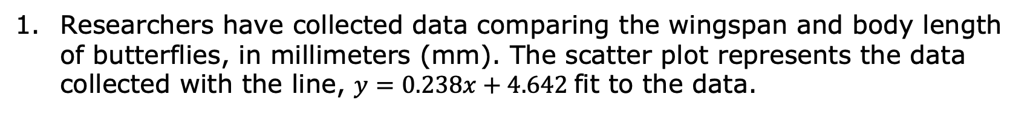
11.6.5 Your Turn!
Researchers have collected data comparing the wingspan and body length of butterflies, in millimeters (mm). The scatter plot represents the data collected with the line, $y=0.238x+4.642$ fit to the data.
Body length (mm)
Wingspan (mm)
Interpret the slope of the equation modeling the relationship.
volume 2, pg. 208

Slide 21

Wrap-Up
volume 2, pg. 208

Slide 22
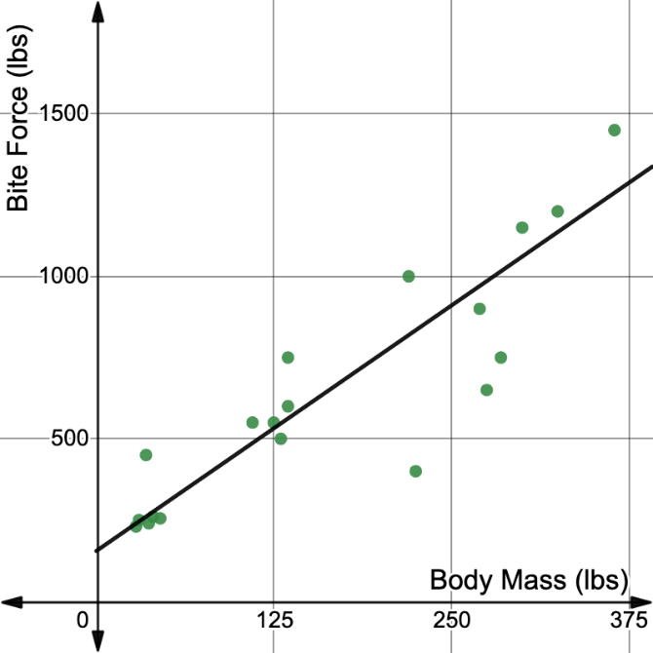
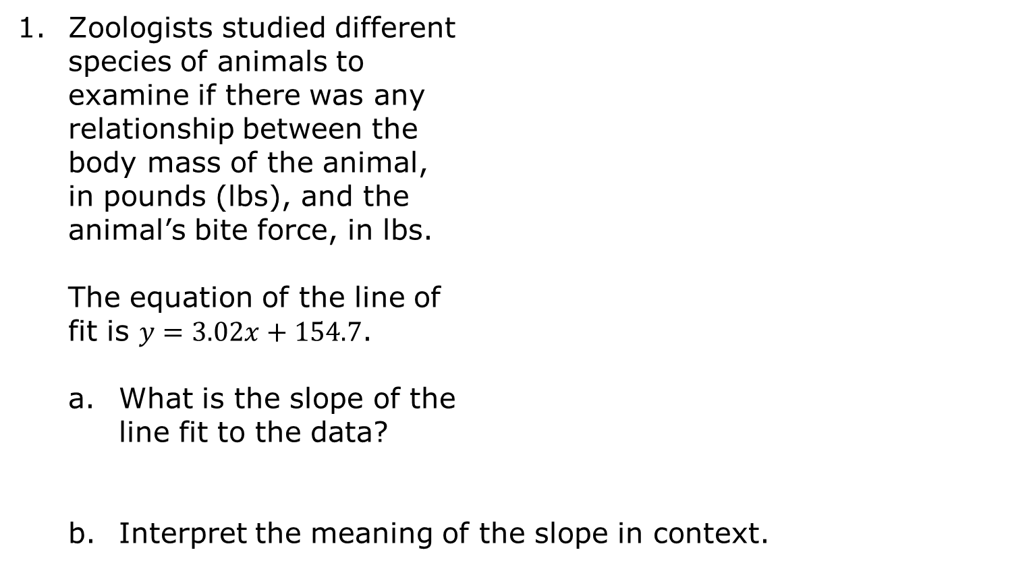
11.6.6 Wrap-Up: Ticket Out the Door
Zoologists studied different species of animals to examine if there was any relationship between the body mass of the animal, in pounds (lbs), and the animal’s bite force, in lbs.
The equation of the line of fit is $y=3.02x+154.7$.
What is the slope of the line fit to the data?
Interpret the meaning of the slope in context.
volume 2, pg. 208

